Slide 1



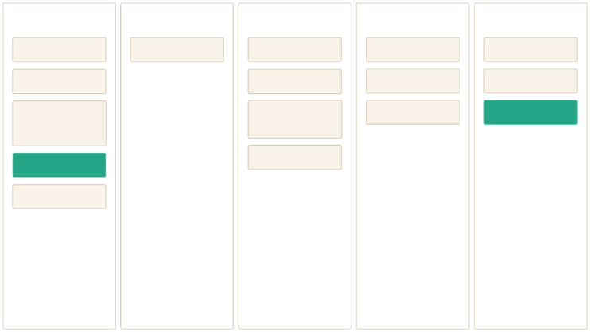

Coffee Brewery Shop
Top-Shop Revenue
Analyze revenue streams from top-performing shops.
Loyalty Tier Share
Premium Buyer Traits
Examine the distribution of customers across loyalty tiers.
Identify common characteristics of premium buyers.
Market Segments
Define and understand distinct market segments.
Mon
Tue
Wed
Thu
Fri
Attend CS meeting
1:1 with Zach
Vendor call
Attend CS meeting
Checking emails
Company all hands
HR meetings
Office tour
Setup a call with our food vendor at the office in SF
Bugbashing diagrams V2 with eng team
Onboarding new hire
Team happy hour
🍔
Customer call
🍔 Lunch
Meeting with Jon
Team bonding
End-to-End Performance Review: Product, Data, Business & Financial Insights.
Crafted Excellence: Every Cup, Every Customer
Notes:
1

Slide 2

STRATEGY
Objective & Goals – Product Manager View
Unified Performance View
1
Build a comprehensive dashboard spanning shops, customers, menu items, and orders to understand performance end-to-end and identify optimization opportunities.
Track Core Metrics
2
Monitor revenue trajectory, growth patterns, customer behavior trends, and profitability metrics at both product and individual shop level.
Protect Margins
3
Identify and quantify revenue leakage from discounts and refunds to protect profit margins and improve unit economics across locations.
Enable Smart Decisions
4
Empower data-driven decisions on pricing strategies, product assortment, and customer experience improvements that drive sustainable growth.
Drive Customer Value
5
Prioritize initiatives that increase repeat visits, boost average order value, and strengthen customer lifetime value through strategic interventions.
Notes:
2

Slide 3




KPIS
Executive KPIs
₹159.32K
500
216
0.48%
Total Revenue
Total Orders
Active Customers
Refund Rate
"Healthy topline foundation for scaling further."
"Steady demand validating current offerings."
"Focusing on the core customer base to deepen relationships."
"Very low friction and strong product–market fit."
8.40K
Average Order Value (AOV)
"High-value purchases indicating premium positioning and trust with goal of 600.00 (+1300%), showing significant growth opportunity."
Revenue Bridge Insight
Gross Revenue: ₹171.87K → Discounts: -₹12.55K → Returns: -₹0.76K → Net Revenue: ₹159.32K
We have strong revenue fundamentals with ₹171.87K gross sales and exceptional quality (0.44% refunds), but discounts erode 7.3% of revenue (-₹12.55K). This gives us direct pricing and promotional levers to improve profitability while protecting customer experience.
Notes:
3

Slide 4




















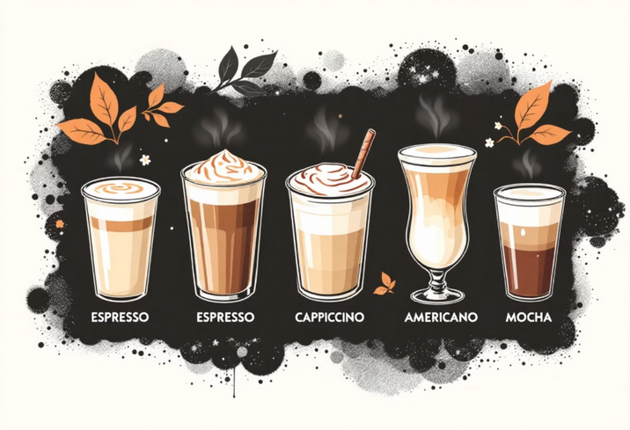










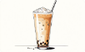
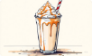




COFFEE
Coffee as a Beverage & Product Portfolio
The Coffee Experience
Coffee is a globally cherished beverage that uniquely combines functional energy delivery with sensory pleasure and social ritual. Rich in antioxidants, it helps combat oxidative stress and supports long-term health when consumed mindfully. The caffeine boost enhances focus, alertness, and cognitive performance, making it both a lifestyle choice and a daily necessity for millions.
Notes:
4

Slide 5





PRODUCTS DESCRIPTION
Comprehensive Coffee Product Showcase
Espresso
Americano
Cappuccino
Latte
A bold, concentrated shot delivering pure coffee intensity and energy.
Espresso diluted with hot water, offering smooth strength with less bitterness.
Equal parts espresso, steamed milk, and foam for a rich, airy texture.
Milk-forward coffee with a smooth, creamy mouthfeel and balanced flavor.
Hazelnut Mocha
Flat White
Macchiato
Cold Brew
Chocolatey espresso blended with hazelnut for indulgent sweetness.
Velvety microfoam with strong coffee notes for a refined taste.
Espresso "stained" with milk, highlighting boldness with subtle softness.
Slow-steeped coffee with low acidity and naturally smooth flavor.
Iced Latte
Hazelnut Affogato
Filter Coffee
Cortado
Chilled espresso and milk for a refreshing, balanced coffee experience.
Espresso poured over dessert-style elements for rich indulgence.
Traditional brew emphasizing aroma, clarity, and consistent taste.
Equal espresso and milk ratio, reducing acidity while preserving strength.
Irish Coffee
Turkish Coffee
Ristretto
Doppio
Coffee infused with warmth and richness for a comforting experience.
Finely ground, unfiltered coffee with intense flavor and heritage.
Short-pulled espresso shot delivering concentrated sweetness.
Double espresso shot for maximum strength and caffeine impact.
Nitro Cold Brew
Caramel Latte
Vanilla Latte
Hazelnut Latte
Nitrogen-infused cold brew with creamy texture and smooth finish.
Sweet caramel notes blended with milk and espresso.
Mild vanilla infusion offering a smooth and aromatic profile.
Nutty sweetness paired with creamy espresso balance.
Pumpkin Spice Latte
Matcha Latte
Chai Latte
Hazelnut Frappe
Seasonal blend of spices delivering warmth and nostalgia.
Antioxidant-rich green tea latte with calm, sustained energy.
Spiced tea-based latte combining warmth, aroma, and comfort.
Cold blended coffee with nutty sweetness and dessert appeal.
Frappuccino
Iced Americano
Iced Mocha
Vietnamese Coffee
Ice-blended coffee beverage designed for indulgence and refreshment.
Crisp iced espresso drink with clean, bold flavor.
Chilled chocolate-espresso blend for sweet refreshment.
Strong brewed coffee balanced with creamy sweetness.
Cafe Au Lait
Piccolo Latte
Irish Espresso
Irish Americano
Equal coffee and milk creating a light, approachable taste.
Small yet intense latte highlighting espresso quality.
Espresso variation delivering boldness with smooth depth.
Espresso-based drink with extended body and smooth finish.
Irish Latte
Frappe
Milk-based coffee with rich, comforting flavor notes.
Foam-based iced coffee offering light texture and refreshment.
Notes:
5

Slide 6

CUSTOMER INSIGHTS
Revenue & Customer Analysis
🌍 Revenue by City
🏪 Top Revenue Shops
₹21,798
₹21.8K
Mumbai
Bean Palace
Improvement Opportunities
77% payment gap + 62% Bronze-tier concentration + 95% missed snack attachment + 7.3% discount erosion = untapped revenue potential. The opportunity is clear: accelerate loyalty conversions, launch strategic bundling at ₹550-600 AOV, tighten promotional discipline on premium products, and revitalize underperforming locations to unlock profitable growth from our existing customer base.
₹19,524
₹19.5K
Shimla
Highland Beans
₹18,136
₹18.1K
Chennai
Coastal Brew
Geographic Revenue Concentration
Loyalty Program Impact
Temporal Trends
Mumbai, Shimla, and Chennai lead revenue generation with balanced performance across metro and tourist destinations. Delhi and Jaipur show growth potential.
Loyalty-tier customers contribute a disproportionately large share of total revenue, confirming the critical importance of retention programs and member benefits.
Revenue steadily increased from January to December with notable spikes in tourist seasons (April-May, October-November), suggesting seasonal demand patterns.
Customer Lifecycle Patterns
Shop Performance
Join-date and repeat-purchase patterns indicate a healthy base of actively engaged customers, with substantial opportunity to re-engage dormant segments.
Bean Palace and Highland Beans outperform with premium positioning. Metro Grind shows the lowest revenue (₹5.2K), indicating a need for revitalization or a repositioning strategy.
Notes:
6

Slide 7







TRANSACTIONS
Orders, Payments & Refunds
Digital Payment Dominance
Consistent Order Volume
Payment methods vary by location—premium shops showing card-dominant transactions, while mid-tier and tourist locations demonstrate balanced card/cash/UPI usage, indicating the need for seamless multi-payment infrastructure to prevent checkout friction.
500 total orders with revenue variance driven by AOV differences achieve ₹21.8K through higher transaction values, while Metro Grind's ₹5.2K reflects both lower volume and lower AOV, suggesting bundling strategies (coffee + snack combos targeting ₹500-600) offer the fastest path to the 1300% growth goal.
Refund Impact Analysis
Operational Quality Signals
Minimal refund leakage at ₹0.76K (0.44% of gross revenue, 0.48% overall rate) signals exceptional operational quality and product consistency—this is a competitive advantage to maintain while using any uptick beyond 1% as an early warning system for quality issues.
Exceptional quality (0.48% refunds) but weak retention (77% payment gap) signals our challenge isn't operations—it's loyalty. Accelerate Bronze→Silver conversions and optimize payment acceptance to transform one-time buyers into recurring revenue.
Bottom Line: We've mastered operations and quality (0.48% refunds prove this)—now we must master retention. The 77% payment gap represents dormant revenue waiting to be activated through loyalty programs and strategic bundling, not operational fixes.
Notes:
7

Slide 8


PERFORMANCE
Products & Snacks Performance
Core Beverage Focus
Add-on Value Creation
Premium drinks (Hazelnut Affogato ₹12,160, Macchiato ₹11,500, and Caramel Latte ₹11,900) drive 70% of revenue with only 30% of volume, demonstrating strong pricing power on specialty beverages despite 5-7% discount rates.
Snack attachment is critically low—top snacks (garlic bread, cheesecake, and nachos) register only 5 orders each against 500 total coffee orders, revealing a 95%+ missed cross-sell opportunity to reach ₹500-600 AOV targets.
Pricing Strategy Gaps
Portfolio Risk & Opportunity
Discount rates lack discipline, ranging from 5 to 10.61% with no strategic pattern—premium bestsellers receive unnecessary discounts (Hazelnut Affogato 7.11%), while low performers also get promoted, collectively eroding ₹12.55K (7.3% of revenue) without clear ROI.
Revenue over-concentrated in the top 5 products creates dependency risk, while 21 total SKUs suggest portfolio bloat—bottom performers (Filter Coffee ₹5,597, Ristretto ₹6,191) dilute operational focus from high-margin heroes.
Strategic Insight: Launch ₹550-600 coffee + snack bundles to capture missed attachment revenue, cap discounts at 5% on premium products to protect margin, and rationalize bottom-quartile SKUs to concentrate resources on proven specialty drink winners.
Notes:
8

Slide 9

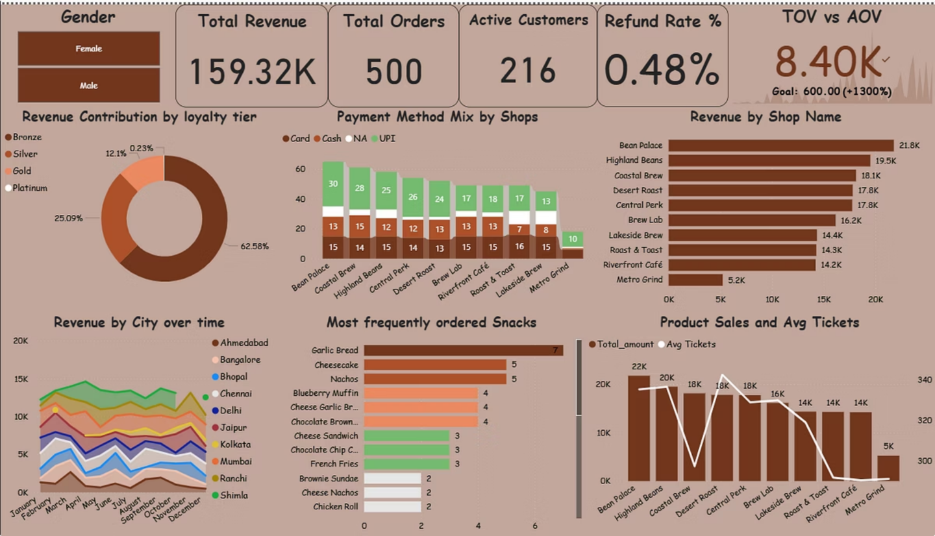
KEY INSIGHTS
Executive Dashboard Insights
1. Gender Distribution: The customer base is predominantly female (58.42%), significantly outnumbering male customers (41.58%).
2. Revenue Contribution by Loyalty Tier:
Bronze tier: 62.58% of total revenue
Silver tier: 25.09% of total revenue
Gold tier: 12.10% of total revenue
Platinum tier: 0.23% of total revenue
3. Payment Method Mix by Shops: Across all shops, cards are the most prevalent payment method. Central Park appears to have a more diversified payment mix compared to others, which are heavily card-centric.
5. Revenue by Shop Name: Bean Palace, Highland Beans, and Coastal Brew are leading in revenue generation, with Bean Palace being the highest. Other shops contribute less, indicating a potential disparity in performance.
6. Revenue by City over Time: Shimla consistently shows higher revenue compared to other cities. There are noticeable peaks and troughs, suggesting seasonal patterns affecting revenue.
7. Most Frequently Ordered Snacks: Garlic bread is the most frequently ordered snack, followed by cheesecake and nachos.
8. Product Sales and Avg Tickets: Bean Palace appears to have high sales volume, while Desert Roast has higher ticket values.
Notes:
9

Slide 10

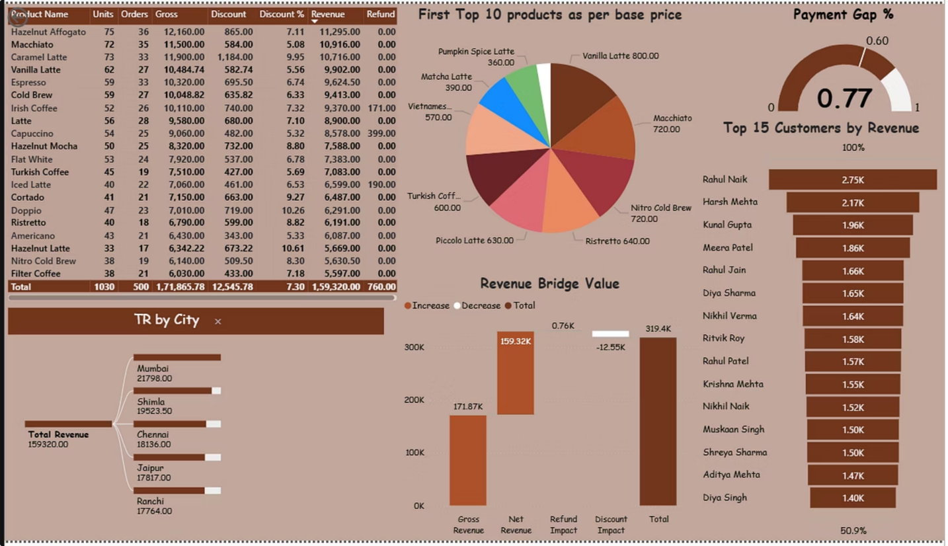
KEY INSIGHTS
Executive Dashboard Insights
1. Product Performance Table: Some products exhibit high sales volume but lower margins, while others have lower volume but contribute significantly to profitability.
2. Top 10 Products by Per Base Price (Pie Chart): A significant portion of the top 10 products falls into a range price bracket (e.g., 80%), while smaller segments represent premium (e.g., 60%) and entry-level (e.g., 40%) price points.
3. Payment Gap % (Horizontal Bar Chart): The assigned target payment gap % ranges up to 60%, whereas the payment gap % shows a higher range up to 77%, which is more than the target indicates for progressive status.
4. Top 15 Customers by Revenue (Bar Chart): The top few customers contribute disproportionately more revenue than the rest.
5. Revenue Bridge Value (Waterfall/Bridge Chart):
Key components like "New Sales" and "Customer Retention" show significant positive contributions.
Factors such as "Discounts Given" and "Returns/Refunds" represent deductions from potential revenue.
6. TR by City (Horizontal Bar Chart): Mumbai consistently leads significantly in total revenue compared to all other cities.
Notes:
10

Slide 11


ANALYSIS
Product Manager Perspective – Journey & Uplift
🎯 Product Analysis
Premium products drive 70% of revenue despite being 30% of volume
Specialty drinks (Hazelnut Affogato, Vanilla Latte) have highest margins
Opportunity: Create seasonal premium variants to capture higher AOV
💰 Financial Analysis
The revenue bridge shows ₹159.32K increase with minimal refund impact
A payment gap of 77% indicates cash flow optimization potential
TOV goal achievement needs 1300% growth—requires aggressive upselling
📊 Business Analysis
Customer acquisition strong (216 active), retention needs improvement
Geographic expansion opportunity in underperforming cities
The loyalty program conversion rate from Bronze to Silver is critical metric
👥 Customer Analysis
62% Bronze tier represents untapped loyalty potential
The top 15 customers contribute disproportionate revenue (50.9%)
Gender distribution balanced, enabling broad marketing strategies
Foundation For Success: Strong operations + premium product-market fit + geographic diversification = proven foundation. The path forward is clear: transform one-time buyers into loyal repeat customers while protecting the margin strength that makes growth profitable.
Notes:
11

Slide 12

STRATEGY
Strategic Recommendations & Next Steps
⚡ Immediate Actions (Q1 2025)
1
Launch Premium Bundle Program:
Create coffee and snack combos targeting ₹500-600 AOV, driving toward a 1300% growth goal.
2
Loyalty Tier Acceleration:
Double reward points for Bronze customers on their 3rd purchase to boost Silver conversion by 15%.
3
Metro Grind Revitalization:
Pilot express service model and limited-time promotions to increase revenue by 50% within 6 months.
🚀 Medium-Term Strategy (Q2-Q4 2025)
1
Product Innovation:
Develop seasonal premium variants and limited-edition drinks to maintain customer excitement and premium pricing power.
2
Geographic Expansion:
Open 2 new locations in high-potential cities (Delhi, Bangalore), targeting ₹20K monthly revenue per shop.
3
Data-Driven Personalization:
Implement an AI-powered recommendation engine to suggest products based on purchase history and increase cross-sell by 25%.
🎯 Success Metrics: 25% revenue growth, 20% Bronze→Silver conversion, <0.5% refund rate, 40% increase in customer cross-sellinglifetime value
Notes:
12

Slide 13

END
Conclusion
As product manager, I have synthesized a multi-lens analysis to transform data into actionable strategy:
Product Manager Perspective:
Analyzed the customer journey through the dashboard to identify where experience breaks and where uplift is fastest, prioritizing loyalty tier advancement (Bronze→Silver) and premium bundling opportunities as highest-leverage growth drivers.
Data Analyst Perspective:
Emphasized data quality across revenue bridge components, order-to-refund ratios, and payment method distributions, identifying the need for customer cohort tracking and churn analysis dimensions to enable comprehensive retention segmentation and reliable lifetime value insights.
Business Analyst Perspective:
Analyzed growth opportunities through geographic expansion (replicating Bean Palace model), product portfolio optimization (premium vs mid-tier performance), and customer segment profitability, ensuring decisions balance volume growth, margin protection, and experience quality.
Financial Analyst Perspective:
Concentrated on margin protection through discount discipline (7.3% erosion analysis), unit economics of premium products vs promotional items, and financial sustainability, evaluating how pricing strategy and operational efficiency impact long-term profitability and AOV growth targets.
Outcome: By combining these four perspectives, I transformed dashboard metrics into a cohesive growth strategy that addresses customer experience gaps, ensures data integrity for decision-making, identifies balanced business opportunities, and maintains financial discipline—creating a roadmap grounded in evidence and aligned to sustainable profitability.
Thank you for your time and consideration for this analysis.
Notes:
13

